Slide 1




Trading social status for genetics in marriage markets: Evidence from UK Biobank
Abdel Abdellaoui, Oana Borcan and David Hugh-Jones
IFO Genes and Inequality conference

Slide 2
Basic thesis of modern behavioural genetics:
Genetic data explains social outcomes.
What’s a social scientist to do?
One answer: find out where the genes come from.
Genetic assortative mating (Hugh-Jones et al. 2016).
Geographic sorting (Abdellaoui et al. 2019).
Natural selection (Hugh-Jones and Abdellaoui 2021, working paper).
This paper.

Slide 3
Inequality persists over generations. It can be surprisingly persistent over time (Clark and Simmons 2015; Solon 2018).
Families are part of the mechanism, since wealth, human capital and other traits are passed from parents to children.
Inherited human genetics help to explain inequality:
Heritability of occupational class and educational attainment is about 50% (Tambs et al. 1989).
2-year-old children’s family socio-economic status can be predicted from their genes (Trzaskowski et al. 2014).
Polygenic scores for educational attainment predict occupational class (Rimfeld et al. 2018).
The leading explanation for this gene-status gradient is meritocracy. “Good genes” lead to upward mobility.

Slide 4
We offer a new explanation for the genes-status gradient, based on assortative mating (Fernandez and Rogerson 2000; Fernandez et al. 2005; Schwartz and Mare 2005; Greenwood et al. 2014; Eika et al. 2019).
Social status and “good” genes both contribute to attractiveness in marriage markets.
Both are inherited.
As a result, social status and genetics become associated in the next generation.
Shocks to social status are reflected in children’s genetics.
Gene-status gradient is likely historically widespread.
We test this theory using data from the UK Biobank.

Slide 5
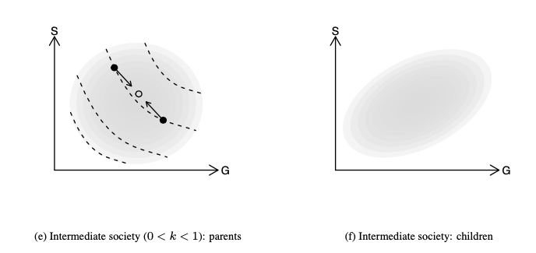
Model

Slide 6
Data
UK Biobank, a study of about 500,000 individuals born 1935-1970. Contains questionnaire data on health and social characteristics, also DNA data. Non-representative!
We don’t have explicit information on spouse pairs.
We categorize people as pairs if they:
• had the same home postcode
• have the same homeownership/renting status, length of time at the address, and number of children
• attended the same UK Biobank assessment centre on the same day;
• both reported living with their spouse (“husband, wife or partner”);
• consisted of one male and one female.
We validate these pairs using genetic children, also in the database.

Slide 7
Our dependent variable is spouse’s Polygenic Score for Educational Attainment (PSEA).
This is a DNA-derived summary statistic which predicts people’s level of educational attainment.
University attendance by PSEA decile

Slide 8
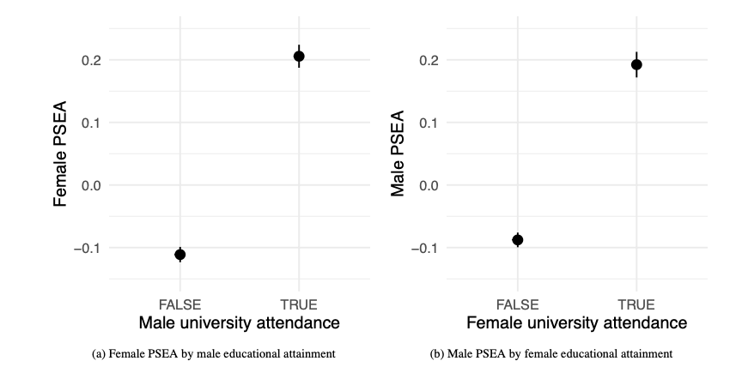

Slide 9
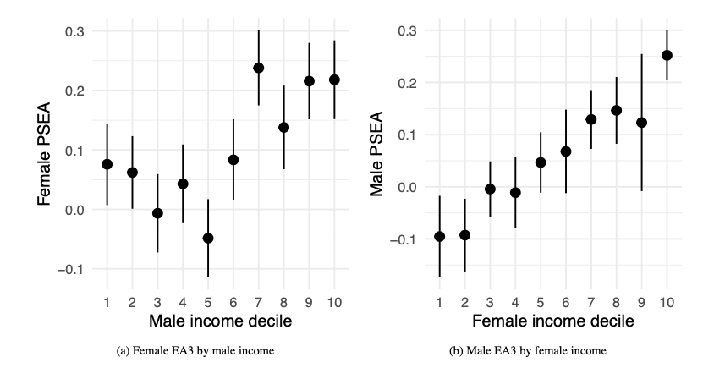

Slide 10
These results could be confounded by the individual’s own genetics.
We already know that there is assortative mating on PSEA (Hugh-Jones et al. 2016).
To avoid this, we need an independent variable which is
independent of genetics;
available for a large enough N.
We use birth order.
Siblings have the same expected polygenic scores, by the “lottery of meiosis”.
Early-born siblings receive more parental care and have better life outcomes including socio-economic status (SES: Lindahl 2008; Booth and Kee 2009; Black, Devereux, and Salvanes 2011).

Slide 11
Estimation strategy
Hard to justify instrumental variables:
Birth order affects other things than SES.
We only have imperfect measures of SES (rough household income, job, educational attainment).
Instead we run a mediation analysis:
Does birth order affect spouse’s PSEA?
Is the effect mediated by measures of SES?

Slide 12
Controls and mediators
Mediators
University attendance
Median earnings of first job (estimated from 2000 SOC code)
Non-SES mediators
Fluid IQ
Height
Controls
Family size
Month of birth
Year of birth
Parent’s age at birth (correlates with birth order! Only available for some respondents)

Slide 13
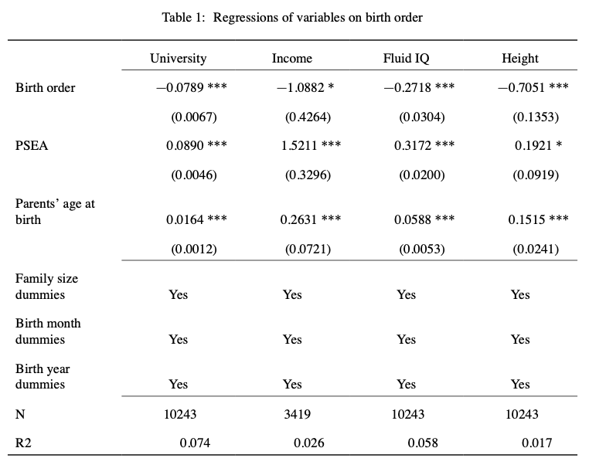

Slide 14
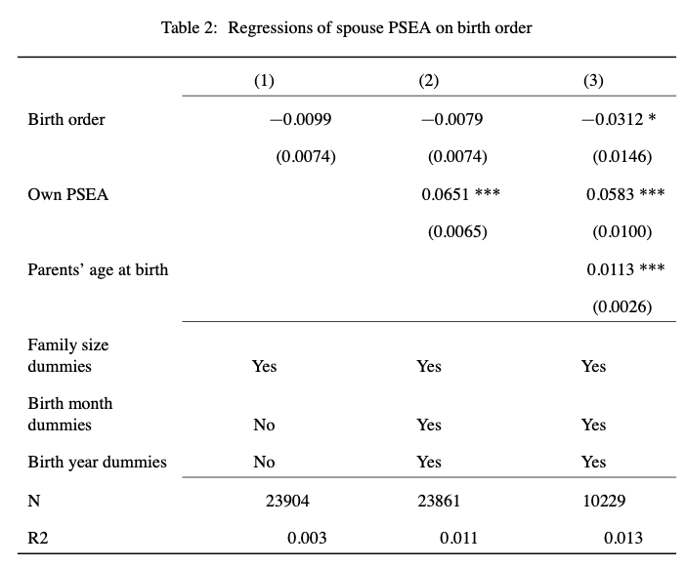

Slide 15
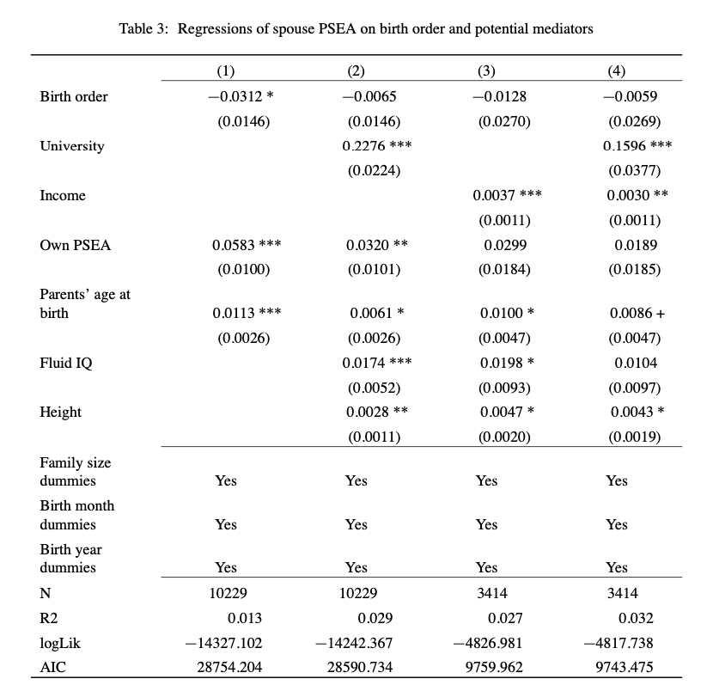
Mediators
Controls

Slide 16
Mediators
Controls

Slide 17
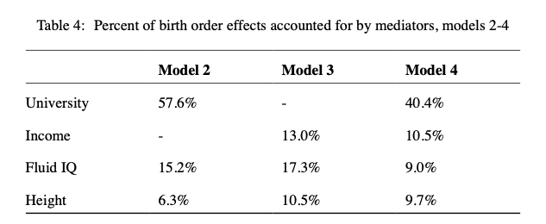

Slide 18
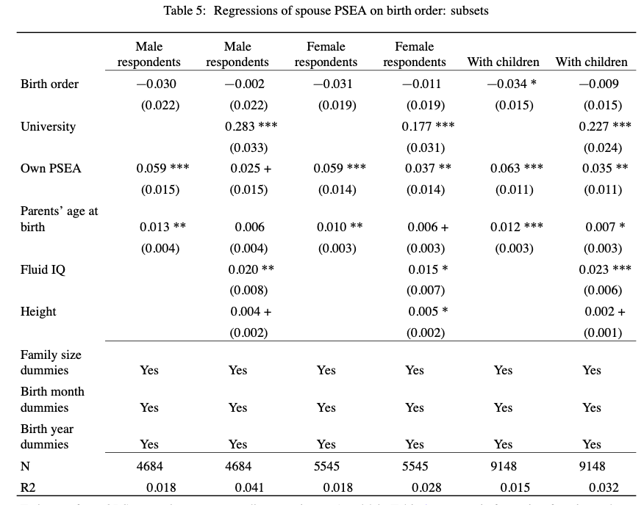

Slide 19
Assortative mating in marriage markets can explain the genes-status gradient.
This explanation applies to a wider range of societies than the key rival.
Prediction: genes-status gradient should be visible in ancient DNA.
Shocks to socio-economic status are reflected in the DNA of descendants.
Part of how elite families maintain their position over time (Clark 2015)?

Slide 20
The media (and scientists!) often oppose “nature” to “nurture”.
The logic is that DNA is fixed at conception, and affects individual outcomes thereafter.
However, across generations, DNA is a social outcome.

Slide 21
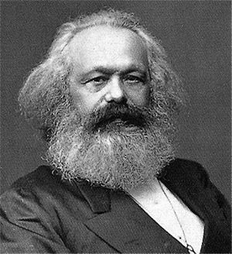

Thanks!
“the effect of ugliness, its repelling power, is destroyed by money.”
“Part of the beauty of me is that I am very rich.”

